Slide 1
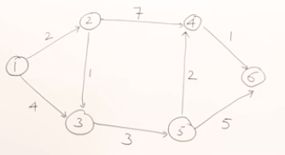
Dijkstra Algorithm
This Algorithm is for single source shortest path problem.
If a weighted graph is given, then we can find shortest path form some starting vertex (V1) to all other vertices.
Shortest path may be direct path or via other edge.
Finding shortest path is a minimization problem, which is an optimization problem and can be solved using greedy method.
Greedy method follows a predefined procedure to give an optimal solution

Slide 2



Dijkstra algorithm provides a predefined procedure (greedy method) to give an optimal solution—min result-shortest path.
Dijkstra algorithm can work on both directed and undirected graph.
Approach of Dijkstra Algorithm
Given a small graph, find shortest path from vertex 1 to 2 and 1 to 3.
Find distance of all vertices from source vertex. Direct edge path/No direct path
Shortest path from vertex V1 to V3 of distance 6 via vertex V2 (No direct path)
It first selects the vertex with the shortest path, then update the shortest path to other vertices, if possible. This operation is called relaxation.

Slide 3
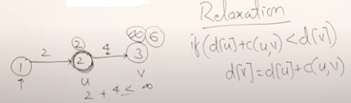
Relaxation of vertices
Whenever we select vertex with a shortest path, we will try to a relax other vertices(means try to find shortest path to all other vertices via selected vertex )
Find connected vertices to the selected vertex, and apply relaxation operation.
Notes:
Vertex 2 has relaxed vertex 3 or has modified the distance of vertex 3

Slide 4
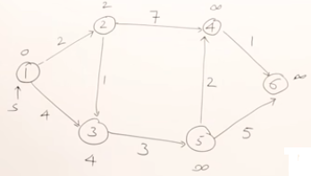
Dijkstra Algorithm
Apply Dijkstra algorithm to solve the graph problem to find the shortest path.
First step:
Source vertex 1, find distances for all vertices from source vertex

Slide 5
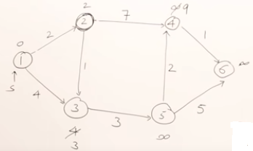
Repeating steps:
from vertex 1, Select the shortest path out of (2,4, ꝏ, ꝏ, ꝏ).
Select the shortest path vertex (V2), then perform relaxation.
Check the connected vertices to V2……..vertices 3 and 4
Modify the distances of vertices 3 and 4. (Vertices 3 and 4 are relaxed)
There is a shortest path from vertex 1 to vertex 3 via vertex 2.

Slide 6
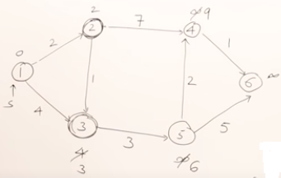
Select the shortest path out of 3, 5 ,9 and ꝏ.
Vertex 3 selected. Check the connected vertex

Slide 7
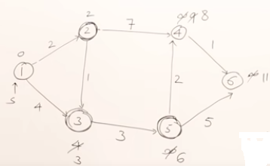
Select the shortest path out of 6,9, ꝏ
Vertex 5 is the shortest path vertex from source vertex

Slide 8
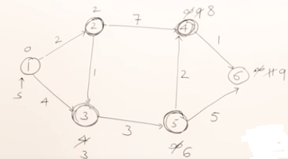
Select the shortest path out of 8, ꝏ
Vertex 4 is the shortest path vertex from source vertex

Slide 9
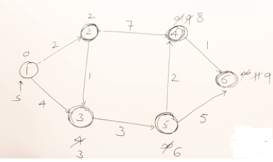
Now we have a shortest path from starting vertex to all other vertices.
V is set of vertices and d(V) indicates distances of all vertices from vertex 1
V | d(V)
2 | 2
3 | 3
4 | 8
5 | 6
6 | 9

Slide 10
Time complexity of Dijkstra Algorithm
Total vertices in the graph n=|V|
Algorithm is finding shortest path to all vertices. At most how many vertices will be relaxed (depends on graph).
Suppose vertex 2 and vertex 3 is connected to all vertices in the graph. All vertices will be checked whether they can be relaxed or not.
So number of vertices that can be relaxed are n
So worst case time complexity of Dijkstra Algorithm in case of fully connected graph is Ꝋ(n x n) or Ꝋ(n²).

Slide 11
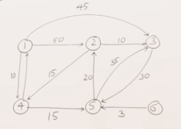
Consider a weighted directed graph, we will run Dijkstra algorithm on it to solve the single source shortest path problem.
Starting vertex: 1, direct edge path from 1 to 2,3,4. select the smallest vertex.
Selected Vertex | 2 | 3 | 4 | 5 | 6
4 | 50 | 45 | 10 | ꝏ | ꝏ
5 | 50 | 45 | 10 | 25 | ꝏ
2 | 45 | 45 | 10 | 25 | ꝏ
3 | 45 | 45 | 10 | 25 | ꝏ
6 | 45 | 45 | 10 | 25 | ꝏ
Path to vertex 6 remains ꝏ as there is no incoming edge on vertex 6

Slide 12
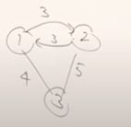
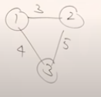
You can run Dijkstra algorithm on undirected graph. We can convert undirected graph into directed graph by adding parallel edges.

Slide 13
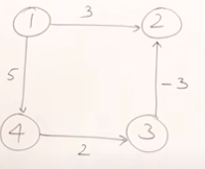
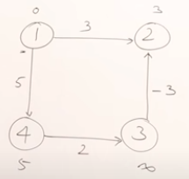
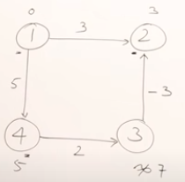
Drawback of Dijkstra Algorithm
Consider a simple graph with negative weighted edge. This negative value is not distance that is measured.
Real world business problems are mapped/represented as graph. Graph shows values and some values may be negative
Dijkstra has not considered negative edge.
Dijkstra has worked even with negative weighted edge.
Notes:
When the vertex is already relaxed or checked, then no need to check it again

Slide 14
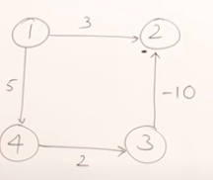
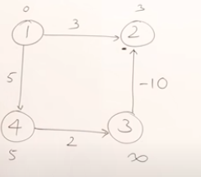
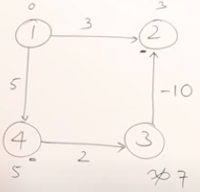
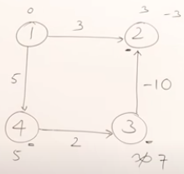
Make a small change in the graph. Vertex 2 is already checked(relaxed), lets check it again. Actually we found a path from vertex1 to 2 is 3, which is wrong. We selected a shortest path to v2 in a hurry. The other possibility path gives a better answer.
Actual correct answer is -3 but Dijkstra algo gives us a wrong answer (3)
Dijkstra algo may or may not work in case of negative edges
Notes:
Dijkstra algo follows a greedy approach which is not trying all possibilities to select the minimum one. It found that this is the minimum and select it.
Greedy appraoch has failed here when there are negative edges

